Slide 1

Amazon Book Recommender System
Project Overview and Insights
By Kyle Rodriguez

Slide 2
Table of Contents
Intro to Recommender Systems 03
Project Goal 04
Data Overview & Wrangling 05
Modeling & Evaluation 06
Model Optimization 07
Final Model Selection 08
Conclusion & Next Steps 09

Slide 3
INTRODUCTION TO RECOMMENDER SYSTEMS
The Role of Recommender Systems
Widely used in user-facing industries such as Netflix, Amazon, LinkedIn and YouTube.
Helps manage large volumes of content by providing relevant suggestions to users.
For example, over 70% of watch time on YouTube is driven by its recommender algorithm.

Slide 4

Project Goal
Objective
Develop a recommender system for Amazon book shoppers
Recommend books users are likely to enjoy based on the reviews of others.
Encourage users to discover books they might not find on their own
Problem Statement
How can we accurately recommend 5 new books to a user using an item-item approach to encourage expanding user preferences to books they may not have otherwise found on their own?

Slide 5

Data Overview & Wrangling
Dataset
Two datasets:
the first consisting of >51M rows containing user ratings on books
the second containing metadata for each book in the initial dataset.
Wrangling
Null values were dropped from the dataset (13%).
Data was downsampled to about 32K rows to manage computational resources.

Slide 6

Modeling & Evaluation
Baseline Models
Several algorithms were tested including SVD, NMF, and KNN-inspired for best baseline results.
Performance Metrics
Models were evaluated for accuracy using MAE and RMSE.
Top Performing Models
The SVD and KNNBaseline models had the best MAE and RMSE scores from the ones tested.

Slide 7

Model Optimization
GridSearch CV
An exhaustive search was done to determine the best hyperparameters for both models.
SVD Model Tuning
Optimized number of epochs, learning rate and regularization parameter.
KNN Model Tuning
Options for similarity measures like MSD and Cosine were optimized as well as the number of neighbors, k.

Slide 8

Final Model Selection
Chosen Model
The tuned SVD model was selected as a basis for the recommendation system since it has the best results.
It was chosen over the KNN model since those tend to become more computationally expensive as the size of data grows.
Predict Top-N Books for Users
Using the recommender system, the top 5 books were predicted for a random user. The metadata was used to provide useful information on each book that was predicted.

Slide 9
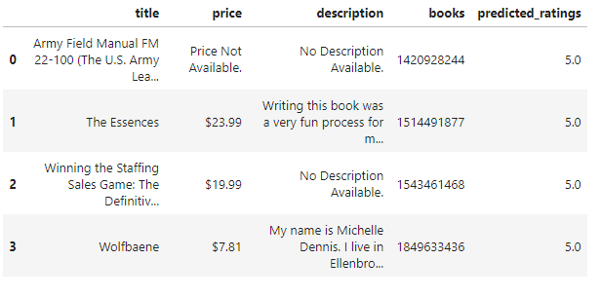
Figure: A pandas DataFrame showing an example of the top 4 recommended books for a user along with the system’s predicted user ratings and metadata about each book.

Slide 10
Conclusion and Next Steps
Project Outcomes
Successfully predict the top 5 recommended books for a user using underlying collaborative filtering algorithm.
The chosen algorithm was the SVD which had an MAE of 0.71 stars.
Next Steps
This system may not scale well as the dataset increases and may need to switch to a more robust recommender system library for handling.
Design an API endpoint for user testing and interfacing via a Flask web app.

